Slide 1
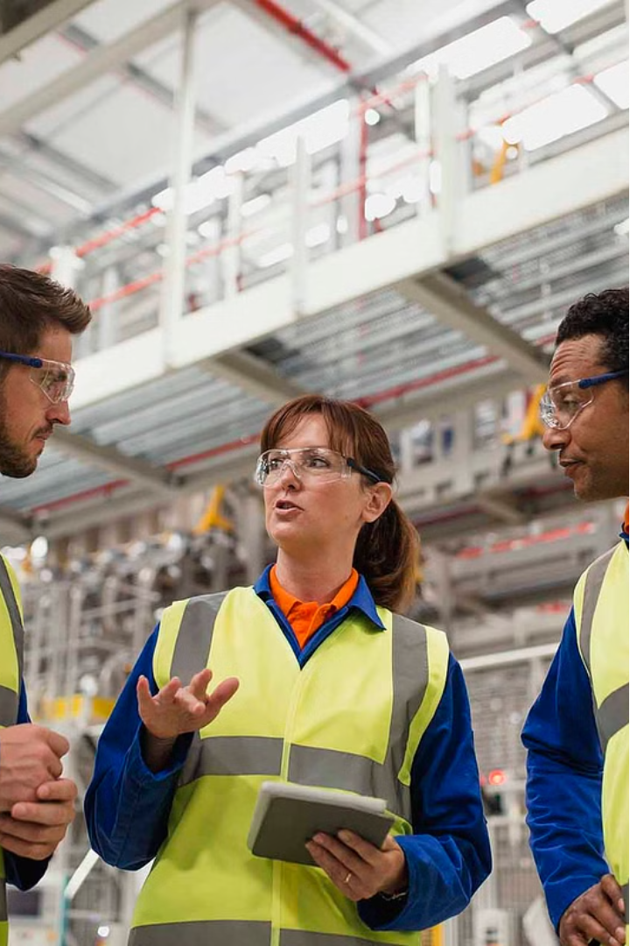

How To Write Safety Observation by Safety Officer?

Slide 3
Unsafe Behavior
Date:
Location: Construction Site - Area B
Observer:
Observation: While conducting a routine site inspection, I observed a worker operating a forklift without wearing a seatbelt. The worker was moving materials across the site and made several sharp turns without securing himself.
Immediate Actions Taken: I approached the worker and instructed him to stop the forklift. I explained the importance of wearing a seatbelt for his safety and the safety of others. The worker complied and put on the seatbelt before resuming work.
Recommendations:
Reinforce the importance of wearing seatbelts during the next safety briefing.
Conduct a refresher training session on forklift safety for all operators.
Implement random seatbelt checks by supervisors.

Slide 4
Unsafe Condition
Date:
Location: Manufacturing Plant - Chemical Storage Area
Observer:
Observation: I observed that several chemical containers were stored without proper labeling. Additionally, some containers were placed on high shelves without adequate support, posing a risk of falling.
Immediate Actions Taken: I immediately informed the site supervisor and ensured that the unlabeled containers were correctly labeled and relocated to a secure, lower storage area.
Recommendations:
Conduct a full audit of chemical storage and ensure all containers are properly labeled.
Implement a regular inspection schedule for chemical storage areas.
Train employees on proper chemical storage and labeling procedures.

Slide 5
Unsafe Practice
Date:
Location: Construction Site - Scaffolding Area
Observer:
Observation: I noticed a worker on the scaffolding was not wearing a fall arrest harness. The worker was approximately 15 feet above the ground, performing tasks without the required personal protective equipment (PPE).
Immediate Actions Taken: I halted the work and instructed the worker to descend safely. I provided him with a harness and ensured he was properly secured before allowing him to continue.
Recommendations:
Reinforce the requirement for fall protection at heights above 6 feet during daily toolbox talks.
Ensure all workers have access to and are trained in the use of fall arrest systems.
Increase the frequency of PPE compliance checks by supervisors.

Slide 6
Safe Practice
Date:
Location: Warehouse - Loading Dock
Observer:
Observation: During my inspection, I noticed that employees were consistently using proper lifting techniques while handling heavy boxes. Each worker bent at the knees, kept their back straight, and used their legs to lift.
Positive Feedback: I praised the team for adhering to safe lifting practices, which help prevent back injuries and other musculoskeletal disorders.
Recommendations:
Continue to reinforce proper lifting techniques in regular safety meetings.
Recognize and reward employees who consistently follow safe lifting practices.
Maintain visual aids and posters on safe lifting techniques in the warehouse.

Slide 7
Safe Condition
Date:
Location: Office Building - Emergency Exits
Observer:
Observation: During my walk-through, I observed that all emergency exits were clear of obstructions, and the exit signs were well-lit and easily visible. Additionally, the emergency exit maps were prominently displayed.
Positive Feedback: I commended the facility manager for maintaining clear and accessible emergency exits, which are crucial for a swift and safe evacuation during an emergency.
Recommendations:
Continue regular checks to ensure emergency exits remain clear and exit signs functional.
Conduct quarterly emergency evacuation drills to ensure employee preparedness.
Keep updating emergency exit maps and communicate any changes to all employees.

