Slide 1

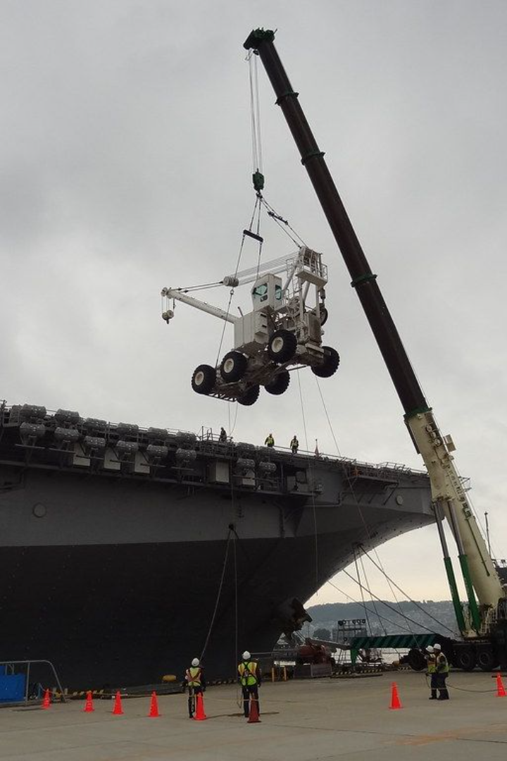
How to Read
Load Chart
100 ton
Crane?

Slide 2

Load Chart
A load chart is typically used in construction or heavy machinery to determine the safe operating capacities of cranes or other lifting equipment based on various factors like boom length, boom radius, and load weight. Here's a general guide on how to read a load chart:

Slide 3
Identify the Load Chart: Load charts are specific to each type of equipment. Find the load chart for the particular crane or machinery you're using.
Understand the Variables: Load charts have multiple variables, including boom length, operating radius, and load weight. These variables affect the machine's lifting capacity.
Boom Length: The horizontal extension of the crane's arm. Load charts display different capacities for different boom lengths. Locate the column or section that corresponds to the boom length you intend to use.
Operating Radius: The distance from the crane's center to the load. Find the row or section that matches the operating radius you'll be working with.
Load Weight: Look for the load weight on the chart. Match it with the intersection of the specified boom length and operating radius. This point on the chart will indicate the safe lifting capacity for that particular configuration.

Slide 4
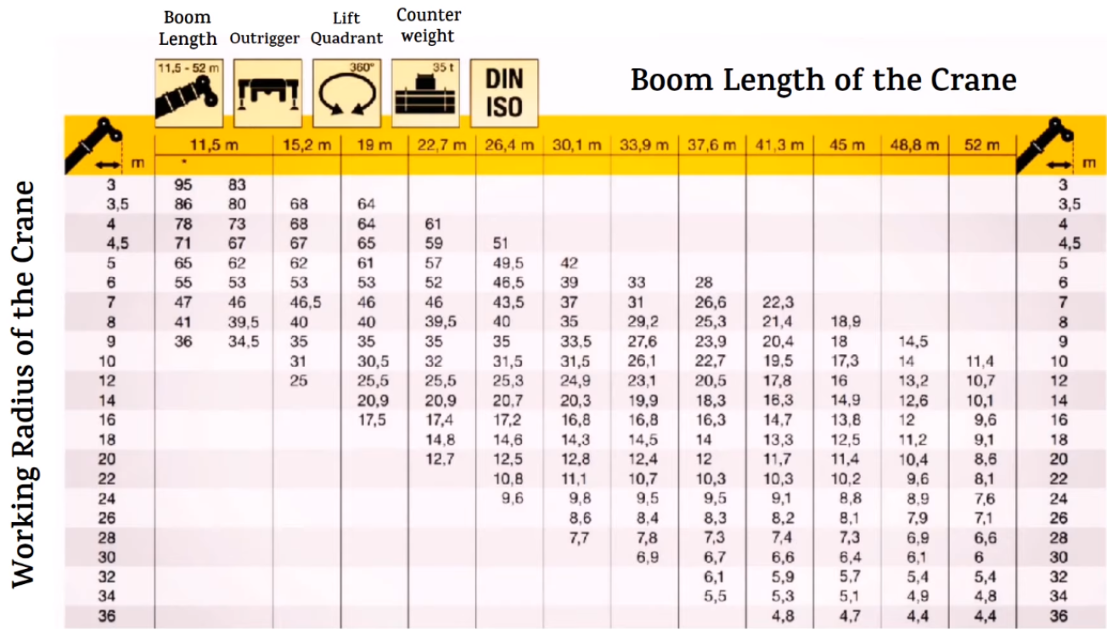

Slide 5
A construction site requires a crane to lift a load of 6 tons at specific boom length and operating radius parameters. The crane operator needs to determine if the crane can safely handle this load at the given configuration.
Load Chart Specifications:
Given:
Boom Lengths: 52 meters
Crane's Boom Length: 52 meters
Operating Radii: 18 meters
Operating Radius: 18 meters
Load Capacities: ?
Load Weight to Lift: 6 tons
Steps to Determine the Capacity:
Identify the column for the 52-meter boom length on the load chart.
Locate the row for the 18-meter operating radius.
Look for the intersection of these values.
Find the load capacity closest to the intended load of 6 tons.

Slide 6
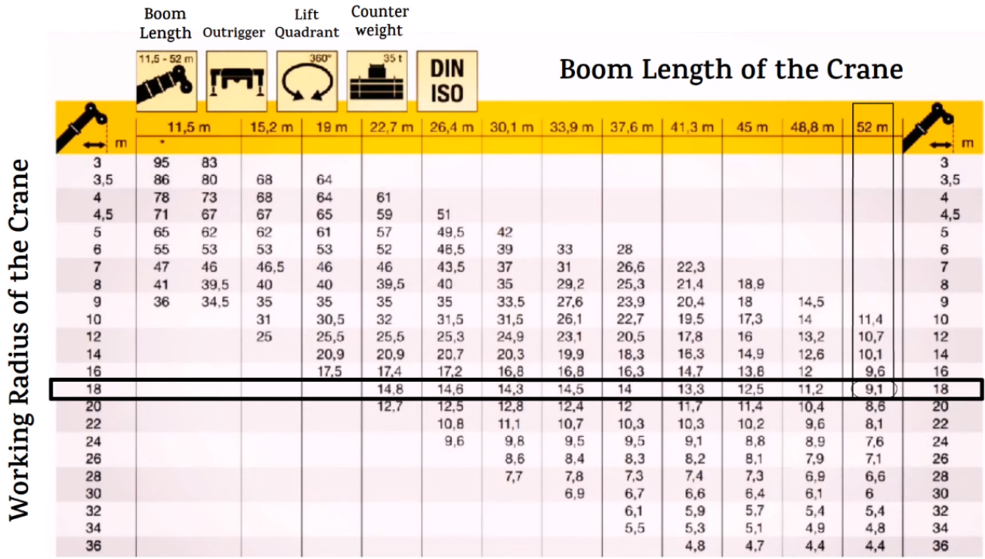

Slide 7
As per the load chart: It indicates that at a 52-meter boom length and an 18-meter radius, the crane's safe lifting capacity shows a maximum of 9.1 tons.
Result: According to the load chart, at the specified boom length and radius, the crane's safe lifting capacity is 9.1 tons. As the intended load is 6 tons, it falls within the safe lifting capacity for this configuration.
Decision: Based on the load chart, the crane can safely lift the 6-ton load at the specified boom length and radius without exceeding the safe lifting capacity. The operation can proceed safely without concerns about overloading.

