Slide 1
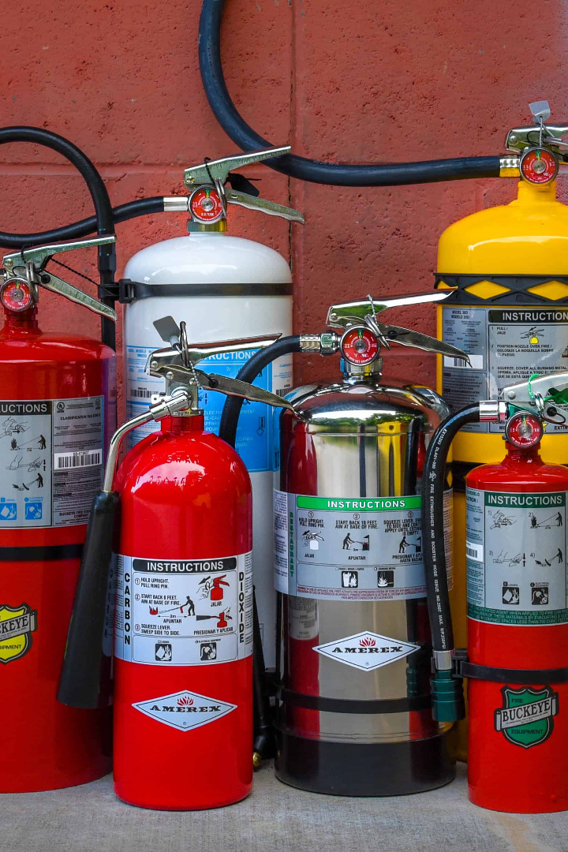
Classification of Fire Extinguisher
Learn about the different types of fire extinguishers and understand which ones are suitable for different classes of fires.

Slide 2
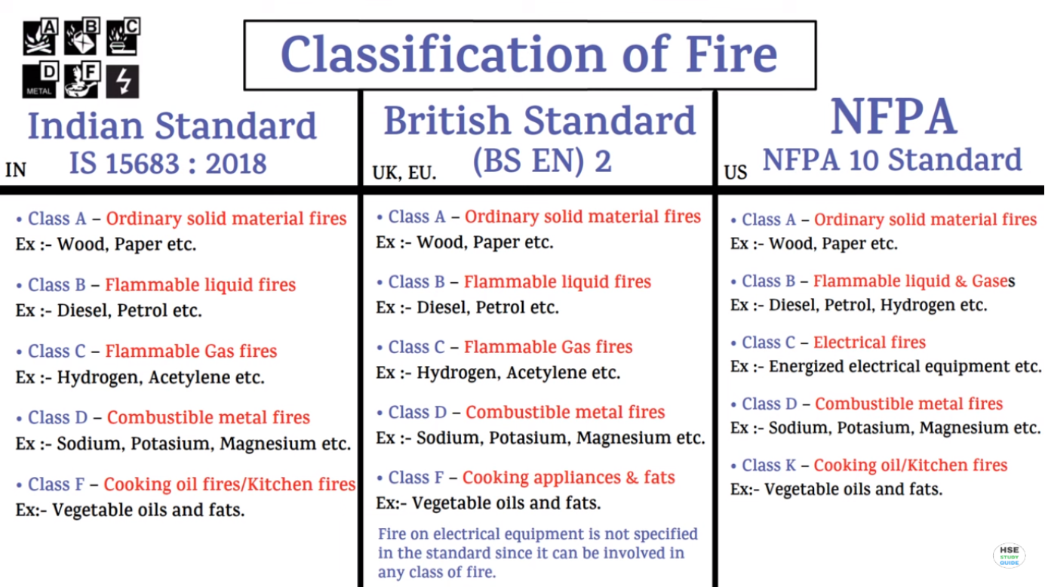

Slide 3
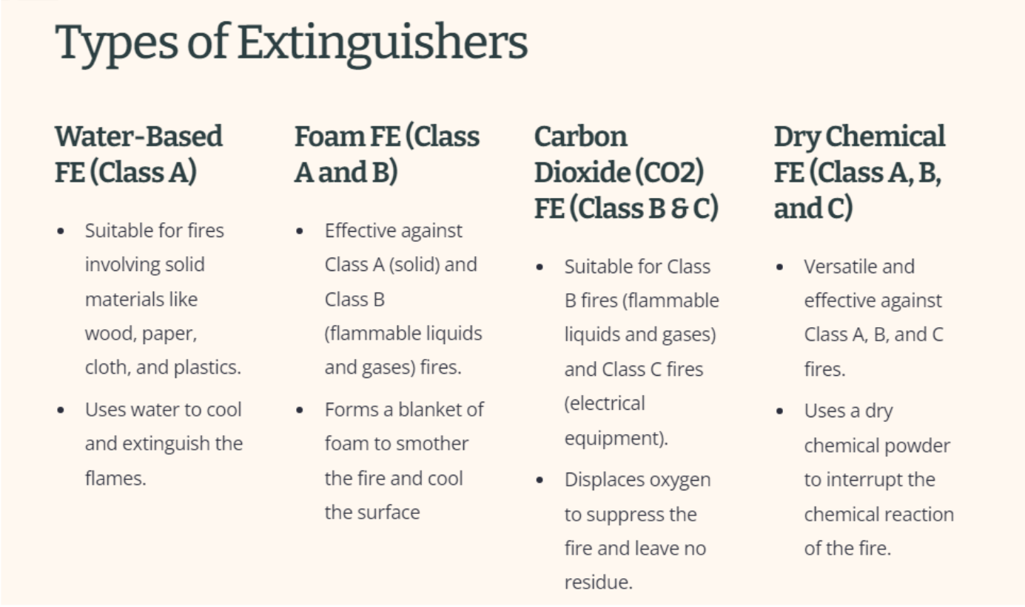

Slide 4
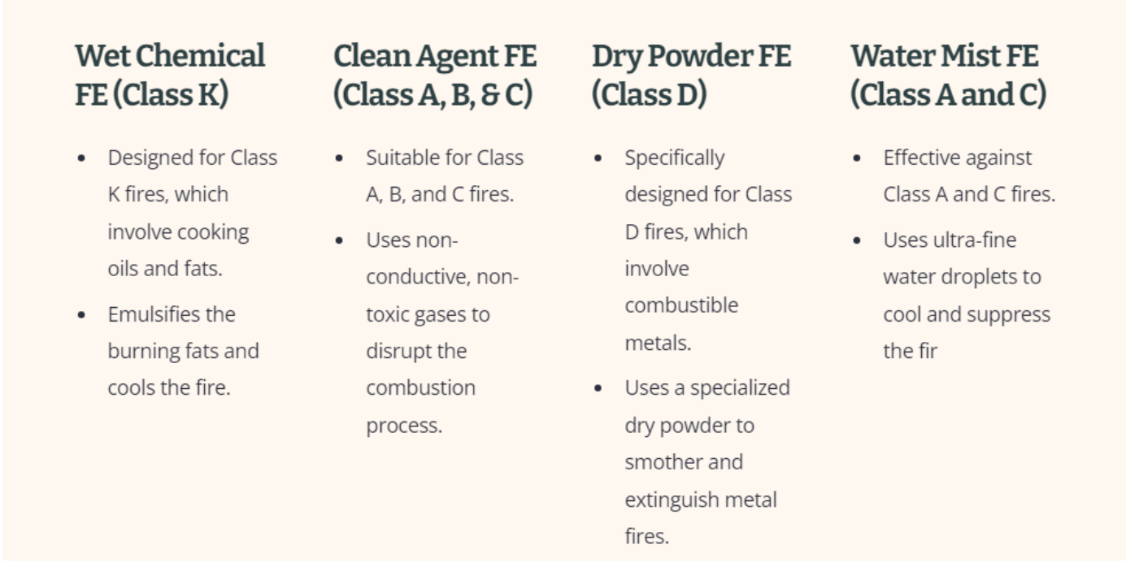

Slide 5
Cartridge-Operated Dry Chemical Fire Extinguishers (Class A, B, and C)
Suitable for Class A, B, and C fires.
Typically larger and used in industrial settings.

Slide 6

Fire Extinguisher Maintenance
1
Regular Inspections
2
Recharge and Replacement
Perform routine visual checks and maintenance to ensure fire extinguishers are in good working condition.
Recharge or replace fire extinguishers after use or according to the manufacturer's recommendations.
3
Professional Servicing
Engage professional fire extinguisher servicing companies for thorough inspections and maintenance.

Slide 7

Fire Prevention is Key
While fire extinguishers are crucial, focusing on fire prevention measures greatly reduces the risk of fire incidents.

