Slide 1

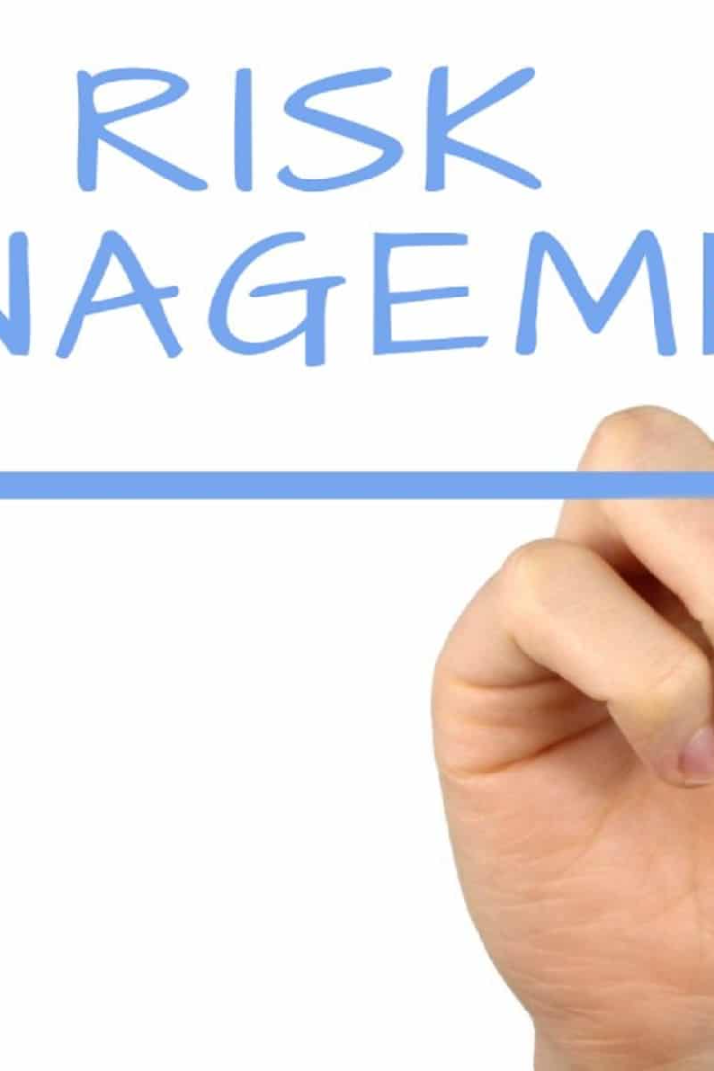
Risk Management
Risk Identification
Risk Assessment
Risk Mitigation
Risk Monitoring

Slide 2

Risk Management
Risk management refers to the process of identifying, assessing, and mitigating potential risks that could affect an organization, project, or individual. It involves analyzing potential threats or uncertainties that could hinder objectives, and then developing strategies to minimize or eliminate those risks. This process typically includes:

Slide 3
Risk Management
Risk Identification: Identifying and recognizing potential risks or hazards that could impact a project or entity.
Risk Assessment: Evaluating the identified risks to determine their likelihood of occurring and their potential impact.
Risk Mitigation: Developing and implementing strategies to reduce the probability or impact of identified risks. This could involve risk avoidance, risk reduction, risk transfer, or risk acceptance.
Risk Monitoring: Continuously monitoring and reassessing risks to ensure that mitigation strategies are effective and to identify new risks that may arise.

Slide 4
Scenario: Construction Site Safety
In a bustling city, a construction company is working on a high-rise building project. The site is a complex environment with various potential hazards and risks to worker safety. The project manager and safety team are actively engaged in implementing risk management strategies to ensure the safety of all personnel involved.

Slide 5
Scenario: Construction Site Safety
1. Risk Identification:
Scenario: During a routine safety inspection, the team identifies multiple hazards, including working at heights, heavy machinery operation, electrical work, and potential material handling risks.
Risk Identified: Falls from height, equipment malfunctions, electrical accidents, and material handling incidents are recognized as potential risks.

Slide 6
Scenario: Construction Site Safety
2. Risk Assessment:
Assessment: The team assesses the likelihood and potential impact of each identified risk. For instance, falls from height are deemed highly likely due to the nature of the construction work and could result in severe injuries or fatalities.
Severity: Electrical accidents and equipment malfunctions are assessed as having a high potential impact due to the risk of electrocution or serious injuries.

Slide 7
Scenario: Construction Site Safety
3. Risk Mitigation:
Strategies Implemented: To mitigate the risks, the construction company implements various measures:
  Installing guardrails, safety nets, and personal fall arrest systems to prevent falls from heights.
  Conducting regular equipment inspections and maintenance to prevent malfunctions.
  Providing comprehensive training on electrical safety protocols and ensuring proper use of personal protective equipment (PPE).
  Implementing strict material handling procedures to minimize the risk of accidents.

Slide 8
Scenario: Construction Site Safety
4. Risk Monitoring:
Ongoing Evaluation: Regular safety inspections and team meetings are scheduled to monitor the effectiveness of implemented measures.
Adjustments: If any new risks are identified or if the effectiveness of existing measures is in question, adjustments are made promptly to enhance safety protocols.

Slide 9

By actively managing risks, individuals and organizations can make informed decisions, anticipate potential problems, and minimize the negative impacts of uncertainties.

