Slide 1



How to Conduct Toolbox talk (TBT) Meeting at Workplace
PERSONNEL PROTECTIVE EQUIPMENT (PPE)

Slide 2

Toolbox talk (TBT) Meeting
A toolbox talk meeting is a short safety meeting or discussion in a workplace setting that focuses on specific safety issues, potential hazards, or best practices related to a particular task or job. These meetings typically involve a small group of workers and are designed to raise awareness, share information, and promote safety measures to prevent accidents or injuries on the job.

Slide 3
Conducting a toolbox talk meeting at the workplace involves a few key steps:
Choose a Relevant Topic
Schedule the Meeting
Prepare the Material
Start the Meeting
Present the Information
Demonstrate and Discuss
Reiterate Key Points
Encourage Feedback
Documentation
Follow-Up

Slide 4
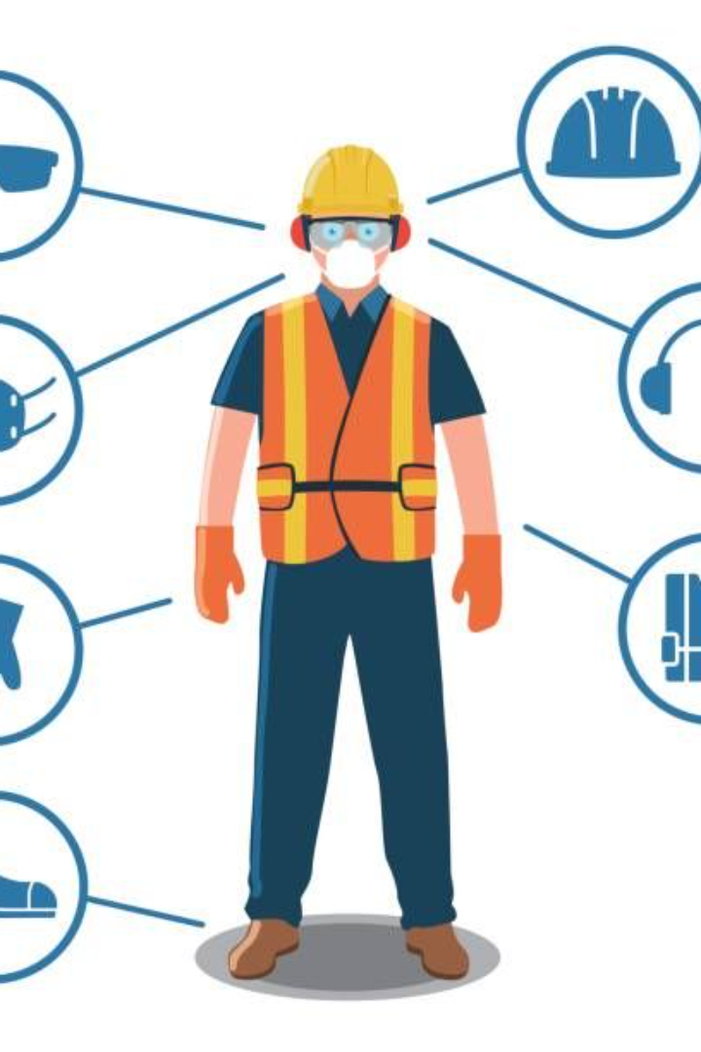
Here's a sample toolbox talk meeting focused on Personal Protective Equipment (PPE):

Slide 5
Title: Personal Protective Equipment (PPE)
Objective: To understand the importance of using appropriate PPE and its role in ensuring workplace safety.
Agenda:
Introduction
Importance of PPE
Types of PPE and their Usage
Proper Use of PPE
When to Use of PPE
Q&A Session
Conclusion and Next Steps

Slide 6
Title: Personal Protective Equipment (PPE)
Objective: To understand the importance of using appropriate PPE and its role in ensuring workplace safety.
Introduction: Good morning, everyone. Today, we're going to discuss a crucial aspect of our safety protocols: Personal Protective Equipment or PPE.
Why PPE Matters: PPE is designed to protect us from workplace hazards that could cause injuries or illnesses. It acts as a shield against various risks we might encounter while performing our duties.
Types of PPE: Let's briefly review the types of PPE we use:
Proper Use of PPE: It's not enough just to have PPE; using it correctly is crucial. Ensure your PPE fits properly and is in good condition. Always follow instructions on how to wear and maintain it.
Head Protection (Hard Hats)
Eye and Face Protection (Safety Glasses, Face Shields)
Hearing Protection (Earplugs, Earmuffs)
Respiratory Protection (Masks, Respirators)
Hand Protection (Gloves)
Foot Protection (Safety Boots)
Body Protection (Safety Vests, Coveralls)

Slide 7
Title: Personal Protective Equipment (PPE)
Objective: To understand the importance of using appropriate PPE and its role in ensuring workplace safety.
When to Use PPE: Anytime there's a risk of injury or exposure to hazards, PPE must be worn. This includes situations involving machinery, chemicals, loud noises, or any other potential danger.
Responsibility: Remember, it's our responsibility to wear the appropriate PPE. If you notice someone not using the necessary equipment, kindly remind them. It's about looking out for each other's safety.
Final Thoughts: Our safety relies on the correct use of PPE. By wearing it consistently and correctly, we significantly reduce the chances of accidents or injuries.
Conclusion: Thank you all for participating. Let's make a commitment to prioritize our safety by using the right PPE every time it's required.

Slide 8


