Slide 1


Difference Between
Job Safety Analysis (JSA)
Job Hazard Analysis (JHA)

Slide 2

Distinguishing JSA & JHA
JSA primarily focuses on identifying potential hazards associated with specific job tasks and formulating preventive measures. In contrast, JHA is a more comprehensive analysis that includes not just hazards but also potential risks and their management strategies.

Slide 3


Slide 4

Purpose and Application
JSA: It involves a step-by-step breakdown of job tasks, analyzing potential risks at each stage and devising preventive measures.
JHA: Goes beyond hazard identification to assess risks comprehensively, including the likelihood of accidents and the severity of their consequences.

Slide 5

Scenario: Construction Site Safety Analysis
At a construction site, the safety officer, Sarah, is tasked with ensuring a comprehensive safety assessment for a new project. Sarah decides to employ both Job Safety Analysis (JSA) and Job Hazard Analysis (JHA) to address potential risks and hazards associated with the project.

Slide 6
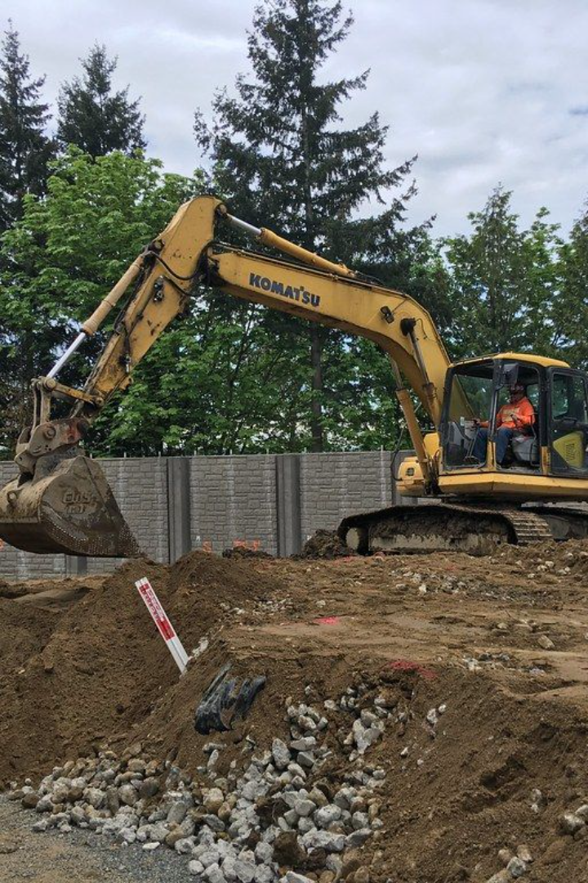
Job Safety Analysis (JSA):
Sarah begins by conducting a JSA for the excavation phase. She breaks down the tasks involved, such as digging, trenching, and material handling. With the team, Sarah identifies potential hazards like cave-ins, falling debris, and equipment malfunctions. They formulate preventive measures like shoring techniques, personal protective equipment (PPE) requirements, and regular equipment maintenance schedules.

Slide 7
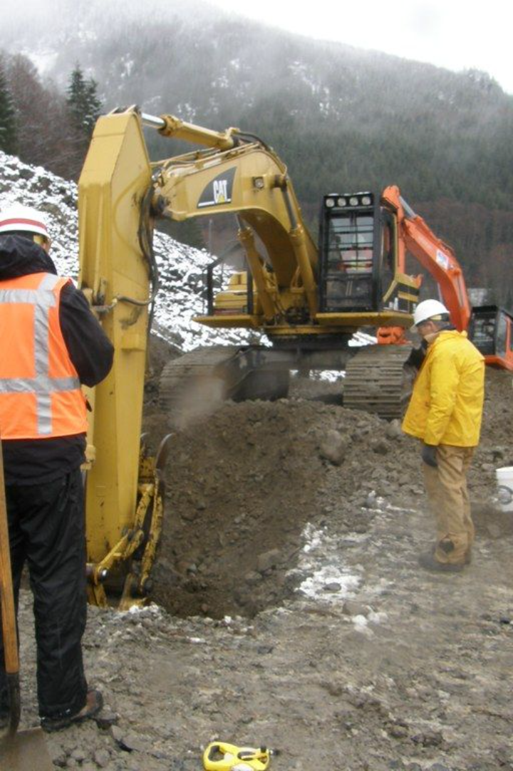
Job Hazard Analysis (JHA):
Moving forward, Sarah extends the analysis to a broader perspective with JHA. She not only considers the hazards identified in JSA but also factors in the likelihood and severity of accidents. In the JHA, Sarah evaluates the probability of a cave-in during trenching and its potential impact on worker safety. She explores the risks associated with specific soil types, depth of excavation, and nearby equipment, devising emergency response plans and evacuation procedures in case of an incident.

Slide 8
Distinguishing Factors:
JSA Focus: Detailed hazard identification and preventive measures at task level.
JHA Scope: Assessing risks comprehensively, considering likelihood and severity of accidents and broader impact.

